Slide 1



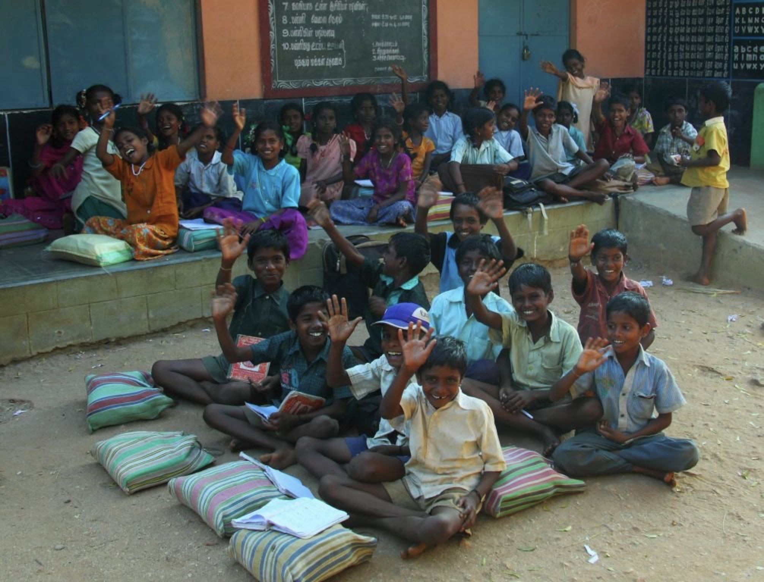
Fly With Books
WEB
APPLICATION
DEVELOPMENT

Slide 2

❏ Group No: 30
Group Leader:
Anirudh Jakhotia
Group members:
Neeraj Dusa
Harish Mullagura
Rakesh Ganeshula
Jayanth Sri Ram Kanduri
Duration: 6-7 hours per week

Slide 3


Project Motivation
The main motivation of the project is to help the poor by giving books for free.The primary focus will be to help the poor,but it will also be helpful to other people as well.

Slide 4
Problem Statement
Problem Solution
In these present situations, it is difficult for poor people to even afford food,thus affording money for buying books has become a big burden for their child's education!!
This website will play a major role in giving books to the poor for free which will be very helpful for them.

Slide 5
Functional Description Modules : 8
Module 1-Blueprint: We will first create a blueprint of our website on a paper.
Module 2-Web Design: We will start designing our website using HTML, CSS and JS for Home page (front end).

Slide 6
Module 3-Prototype: We will design a login and Sign up page after logging in, there will be Account details page for updating information,FAQ,Contact and About Us pages.

Slide 7
Module 4-Client Needs: On choosing
➔ “Buy books” will redirect to a page where there will be a book shelf along with a filter and a search bar.
So, the user can select the desired books and add them to the cart.
➔ “Donate books” will redirect to a page where the donors should fill up the details like the name and address,
number of books,
email and phone number,upon submission it will redirect to status of submission.
➔ “Hall of Fame” will redirect to a page where top donors are listed in leaderboard with the number of books donated and can search donors by their donation ID.

Slide 8

Module 5-Database management and Framework:
Django framework will be used for all created pages.By using MongoDB,we will connect to the database and maintain user records
Module 6-Tracking: In this module, we will have a payment gateway and order tracking.

Slide 9
Module 7-Testing: We will test our website for 2-3 weeks before deploying
Module 8-Deployment: This is the last stage, where we will deploy the website with no bugs

Slide 10
❏ Project Overall Idea: People who want to donate their books can login to this website and can fill in the details of the book like name,genre and condition of the book. If the book is in good condition to read,then he has to give his address and then a pick up guy comes to receive it. Donors get the points or coupons which will be helpful to buy books from website with low cost!! The book will be posted on the website with title, edition, proper photo and grade of the book. Customers who are interested to buy the book can place an order with only delivery charges and order will be received as soon as possible and customers can keep track of order and can contact customer care for any further queries and updates.

Slide 11

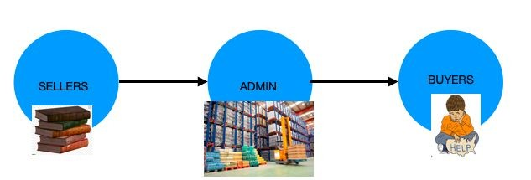

Primary Blueprint

Slide 12


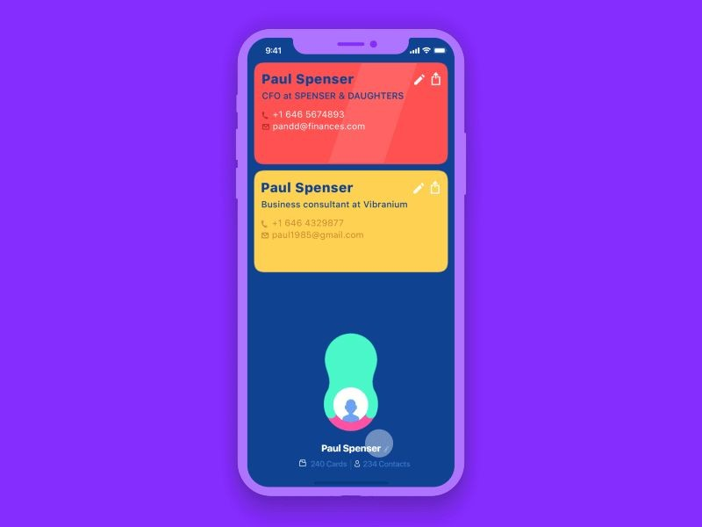
FEATURES
Better UI/UX
Easy Usage

Slide 13

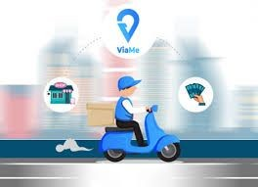
Clean navigational menu
Cash on Delivery

Slide 14

Good quality product photos with image zoom and thumbnails

Slide 15



Wish-list and Add to cart
Engaging and informative “About Us” page with contact details.

Slide 16

Social media connections

Slide 17


Suggestions and user feedback is taken

Slide 18

Secure Login and User information is safe

Slide 19




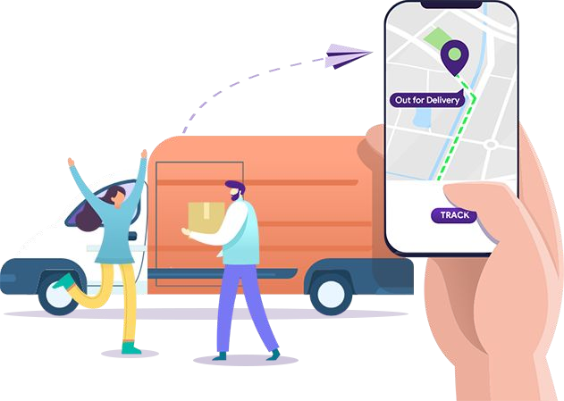
Further Updates
Tracking option for orders

Slide 20
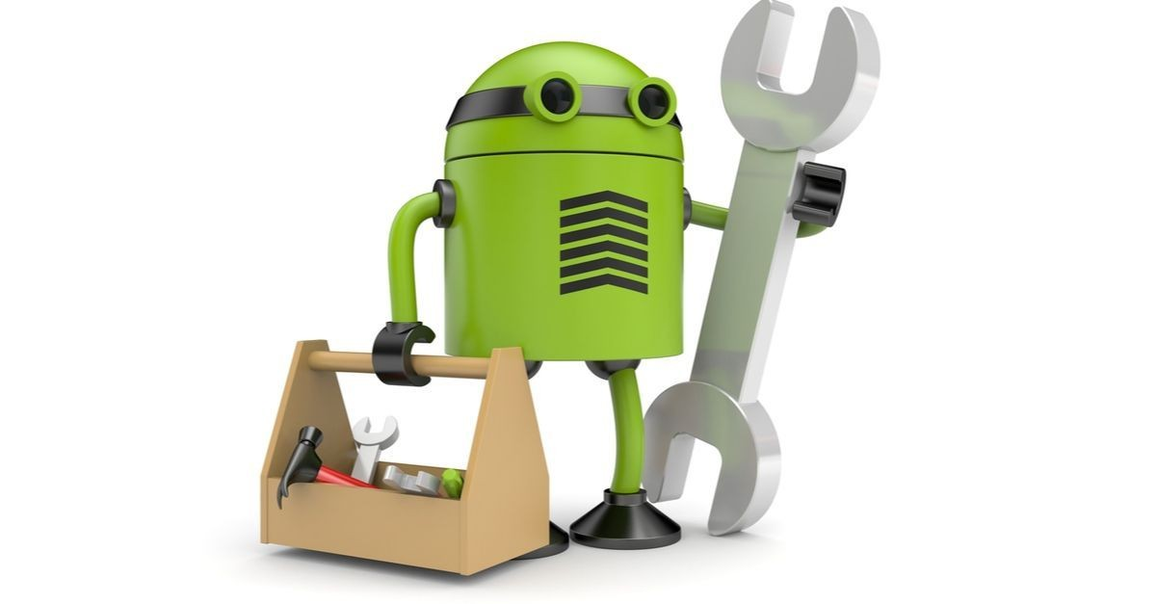
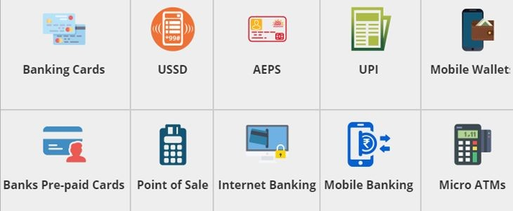
Bug fixes and performance improvements
E-Payment

Slide 21


Discount offers and coupons for Donors

Slide 22

Will soon provide other products along with books

Slide 23
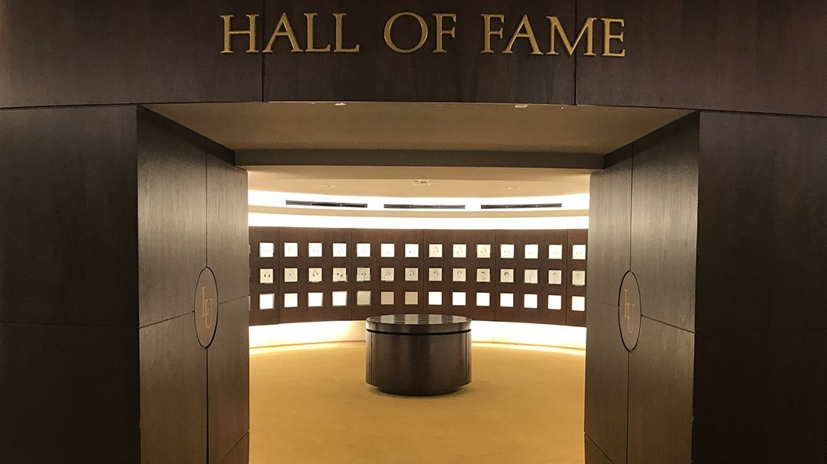
Connectivity
Hall of fame : The top 15 donors are posted in the Hall of Fame with their Name,photo and Contact information.

Slide 24

Delivery can be reached for various possible places of India

Slide 25

Sending email to Others
Can send a direct email for others to check about the website and can suggest a book and can interact with the Donors

Slide 26

QNA Queries
For any queries about the books and other details can ask questions and will be replied soon

Slide 27
Software Components
HTML,CSS,JS,Python,Django,Bootstrap, MongoDB Editor - VS Code
Web Browser - Google Chrome
Graphics Editor - GIMP,Adobe Photoshop
FTP Client - Filezilla
New Software components to be added for further development.

Slide 28



Preliminary work
●
●
●
●
●

Slide 29
Task Assigned
Anirudh Jakhotia : Faq and Login pages (Time Taken:-2.5 weeks)
Neeraj Dusa : Account details page and Navbar
(Time Taken:-2.5 weeks)
Rakesh Ganeshula : Hall of fame (Time Taken :- 2.5 Weeks)
Jayanth Sri Ram Kanduri : About and Contact us pages(Time Taken:-2.5Weeks)
Harish Mullagura :Donate page and footer and Thank you page(Time Taken :-2.5Weeks)

Slide 30
Home and Shop Page was done by all the members of the team together.
Note : The work was assigned to each one of them who were specialized in such areas.
But, We contribute equally in both the front-end and back-end part in developing the website.

Slide 31
Current status of the project :
Current update :- Completed upto fourth module.
Front End Part is Completely done.
The pages done so far :-
Home(Includes buttons)
Shop(Includes each book page,navbar,footer)
Donate(Includes thank you page)
Hall Of Fame(Includes navbar,footer)
About Us(Includes navbar,footer)
Contact Us
Login and Account details(Includes sign up)
FAQ

Slide 32
Future Works
We will connect to the Django Framework for all created HTML pages.
We will use MongoDB to maintain a database of track records of each person
Optional Future Updates :
Tracking of the product
Gifts and Vouchers for donors.
We already created Account Details page for post Log-In but it will be added once after connecting to the database.
In Future, the Add to Cart page will be added with Order Summary and Wishlist.
Also, the checkout form will be added with payment page for confirmation of order.

Slide 33




ANY QUESTIONS?

